Slide 1





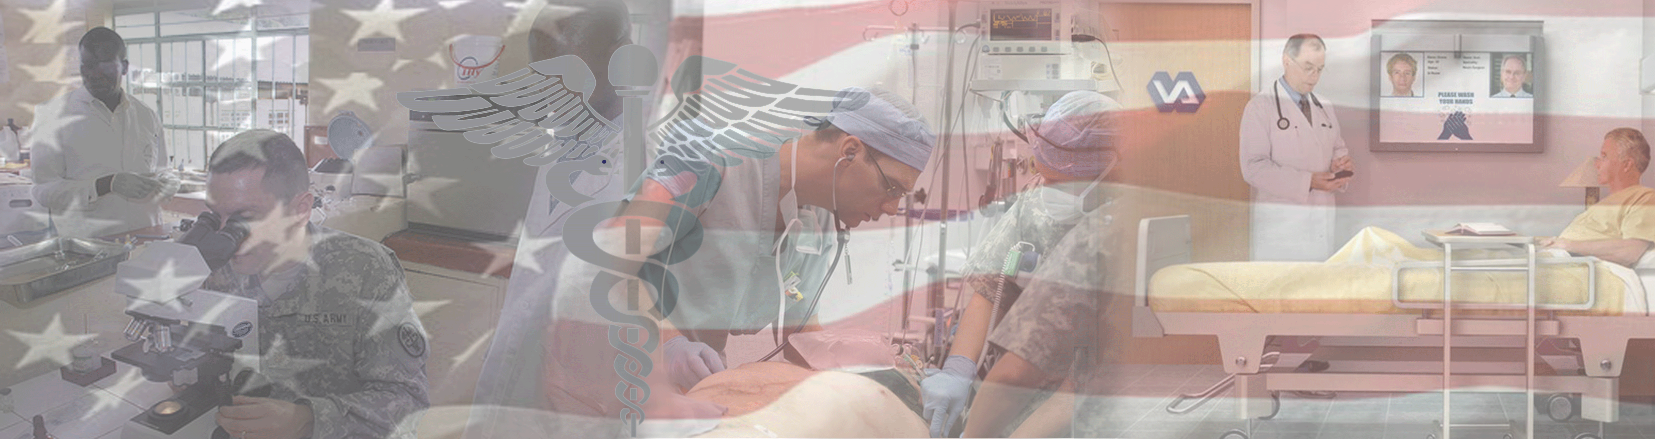

By Light Professional IT Services LLC
www.bylight.com
IHE on FHIR
John Moehrke
<John.Moehrke@byLight.com>
Co-Chair: IHE ITI Planning Committee

Slide 2
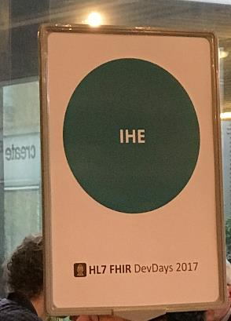
Tutorial Objectives
You should:
Understand the role of IHE in interoperability
Understand the use of FHIR in IHE profiles
These slides presented at
HL7® Workgroup Meeting May 2018 https://www.hl7.org
HL7® FHIR® DEVDAYS June 2018 https://www.fhirdevdays.com/
Notes:
9:15

Slide 3

Common Vision
A world in which everyone can securely access and use the right health data when and where they need it.
Enable seamless and secure access to health information that is usable whenever and wherever needed.

Slide 4
Common Mission
To provide standards that empower global health data interoperability.
IHE improves healthcare by providing specifications, tools and services for interoperability. IHE engages clinicians, health authorities, industry, and users to develop, test, and implement standards-based solutions to vital health information needs.

Slide 5
Domains and Technical/Planning Committees
Conformity Assessment processes and tools
3 Annual Connectathons (USA, Europe, Asia)
Coordinates use of standards such as HL7 and DICOM for specific needs
IHE national deployment committees in 17 countries
Work groups and Steering Committees
Conformance statements for HL7 Standards
3 Annual FHIR Connectathons (preceding HL7 Working Group Meetings)
Develops standards that are often used in IHE profiles (with DICOM, X.12 . . .)
HL7 Affiliates in 55 countries
Both conduct “testing, education, outreach, collaboration with local health agencies”

Slide 6
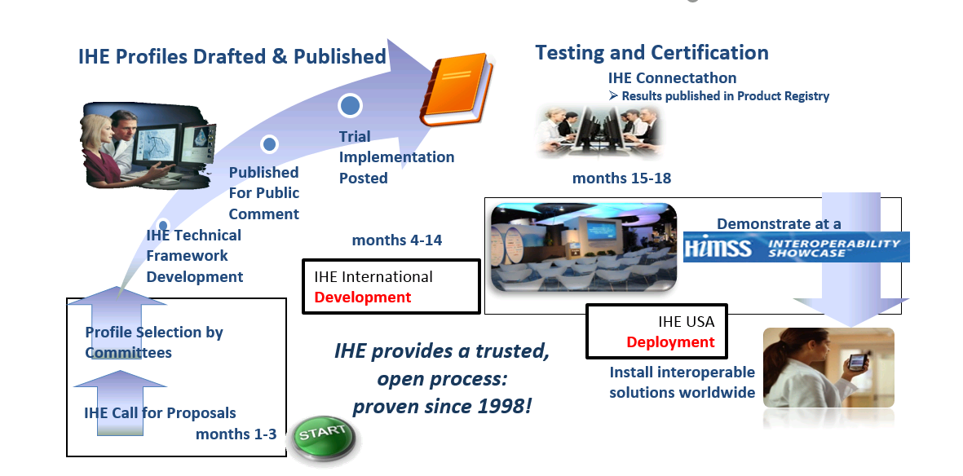
IHE Profile Development: A Proven 1-year Quality Management Cycle
Notes:
Each domain follows its own development schedule, some are aligned (ITI, PCC, QRPH)

Slide 7
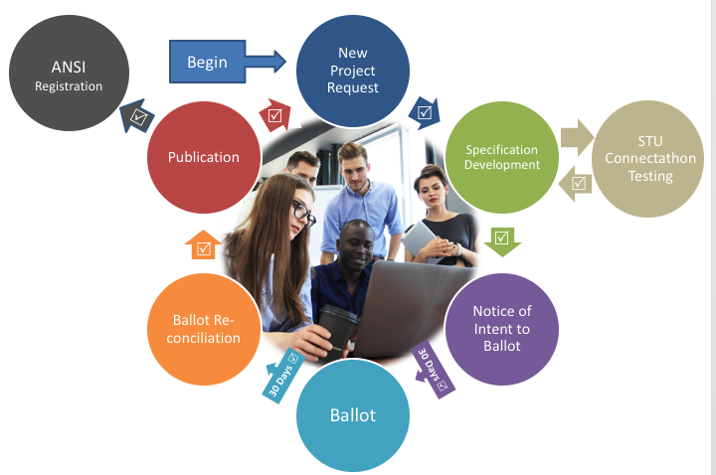
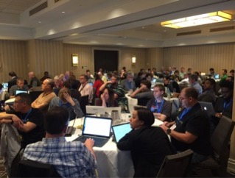
HL7 ANSI-Accredited Standards Process
HL7 work groups meet via conference call and at annual Working Group Meetings (WGMs)
All meetings are open, run under Robert’s rules, with minutes available
STUs and Connectathons allow for ongoing testing by implementers
ANSI rules govern openness, transparency, balance of interests, due process, appeals.

Slide 8
Profiles vs Implementation Guide
IHE creates and maintains implementation guidelines called IHE Profiles, which are published in a set of documents called the IHE Technical Frameworks. IHE Profiles provide a common language for purchasers and vendors to discuss the integration needs of healthcare sites and the integration capabilities of healthcare IT products
HL7 FHIR Profiles define a group of StructureDefinitions (Constraints or Extensions), Value Sets, and examples associated with a FHIR resource for a specific problem or use case
A FHIR Implementation Guide is a set of rules about how FHIR resources are to be used to solve a specific problem
HL7 EHR Functional Profiles define functional requirements for use cases such as Behavioral Health, Child Health, Long term care . . .

Slide 9
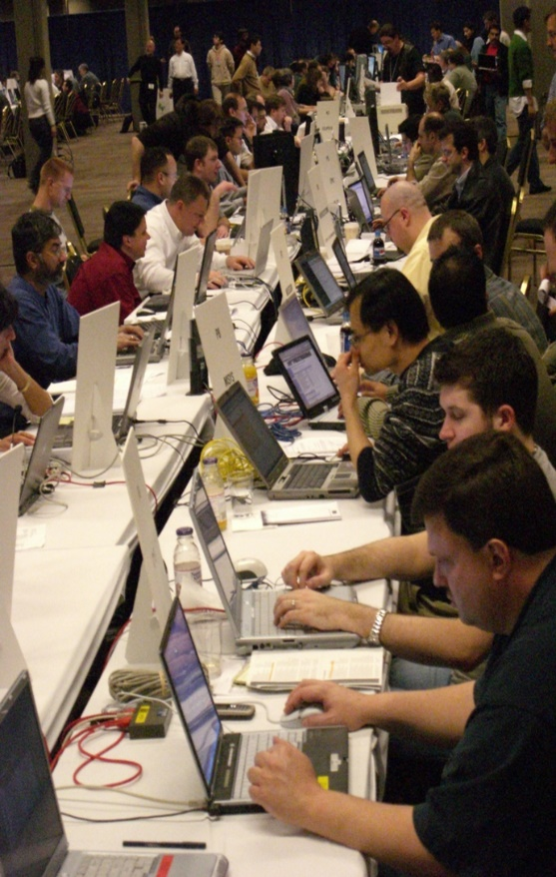
What is a Connectathon?
Cross-vendor, live, supervised, structured testing event
All participating vendors’ products tested together in the same place/time
Experts from each vendor available for immediate problem resolution… fixes are done in minutes, not months!!
Each vendor tests with multiple trading partners (actual product to actual product)
Testing of real-world clinical scenarios

Slide 10
Connectathon – IHE vs FHIR
HL7 FHIR Connectathons help implementers assess, test and explore new opportunities for applying the FHIR specification.
Testing as part of a connectathon is a pre-requisite for progressing resources and implementation guides up the FHIR Maturity Model
IHE Connectathons provide a detailed implementation and testing process to enable standards-based interoperability.
Here systems exchange information in a structured and supervised peer-to-peer testing environment, performing transactions required for the roles that perform in carefully defined interoperability use cases (profiles).

Slide 11

IHE Process
IHE Profiles on FHIR®

Slide 12
IHE: Framework for Interoperability
A common framework for harmonizing and implementing multiple standards
“Meta-Standards” – standards for standards
Profiling existing standards to address specific use cases in healthcare
Promotes unbiased selection and coordinated use of established healthcare and IT standards to address specific clinical needs
Amongst other initiatives, IHE develops profiles that enable seamless health information movement within and between enterprises, regions, nations
Profiles in IHE are equivalent to a FHIR Implementation Guide
E.g., they take a specific use-case, define Actors, define Transactions, and define Options
Source: https://www.ihe.net/FAQ/

Slide 13
IHE Terminology
Integration Profiles
Describe workflow use cases, standards and the overall relationships to achieve transparent interoperability
Integration Statements
Tell customers the IHE Profiles supported by a specific release of a specific product
Technical Frameworks
The documents for each “domain” that specify the Integration Profiles and the associated systems (actors) and transactions
Connectathons
Neutral testing events with multiple vendors in one room, consisting of developers and testers (no marketing or sales / no customers), promoting rapid and robust interoperability testing
Source: https://www.ihe.net/FAQ/

Slide 14
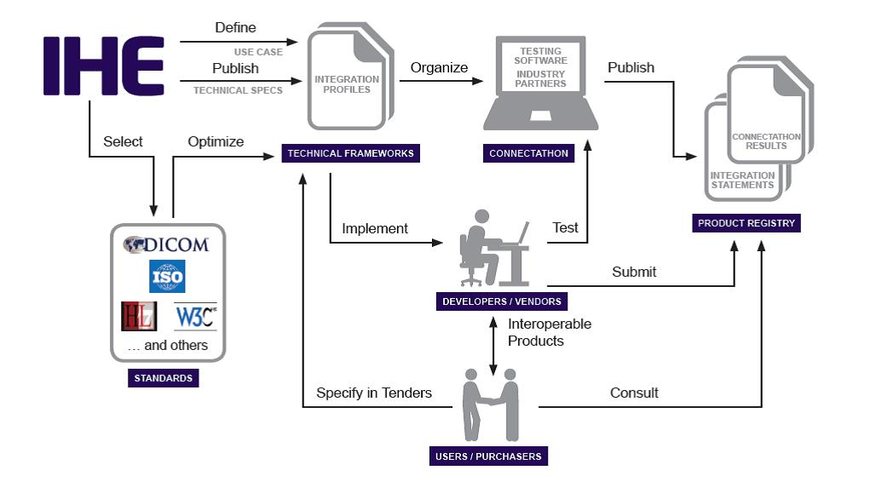
IHE Process
Source: https://www.ihe.net/uploadedImages/Content/About_IHE/IHE_process_flowchart.jpg

Slide 15
IHE Process
Identify Interoperability issues
Develop Integration Profiles
Connectathon Testing
Publish Integration Statements
Vendors list tested profiles
Actors and Transactions
Workflow
Gather relevant standards
{
Profile Proposal
Public Comment
Trial Implementation
Final Text

Slide 16
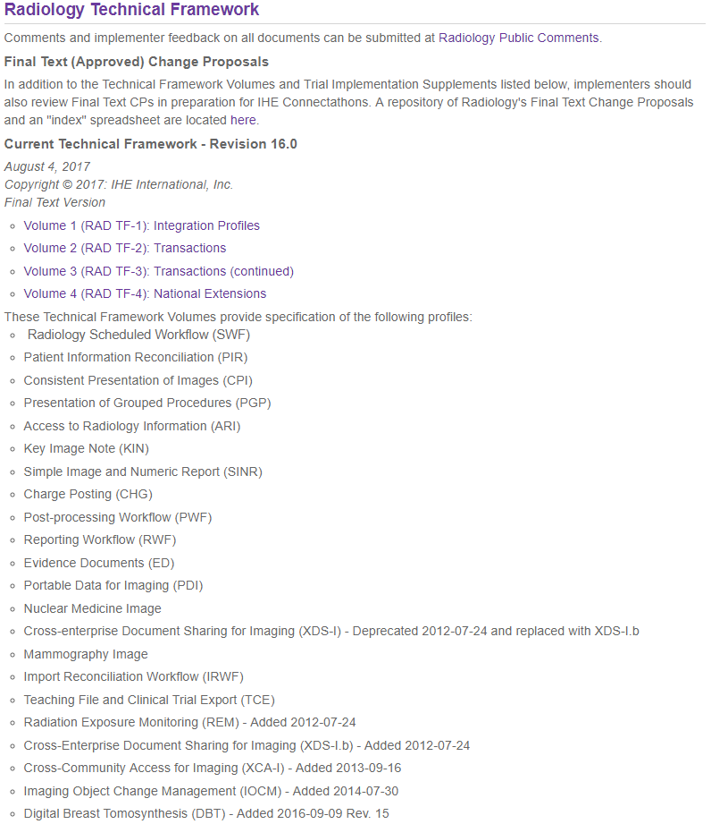
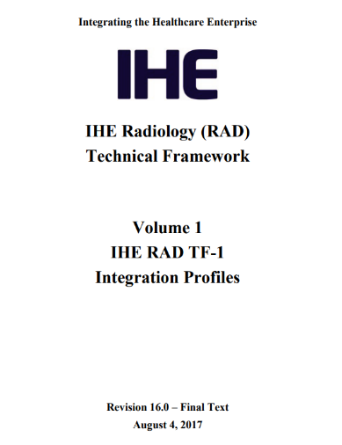
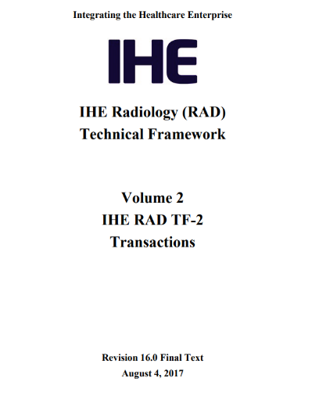
Technical Frameworks
Source: https://www.ihe.net/Technical_Frameworks/

Slide 17
Organization of the Technical Framework
Integration Profile
Integration Profile
Actor
Actor
Actor
Actor
Transaction
{
Roles
Referenced Standards
Detailed Messaging Info
…
Transaction
…
…
Transaction
Transaction
Transaction
Transaction
Transaction
Transaction
Transaction
Transaction
Source: https://www.ihe.net/FAQ/#What_is_the_IHE_Technical_Framework?

Slide 18
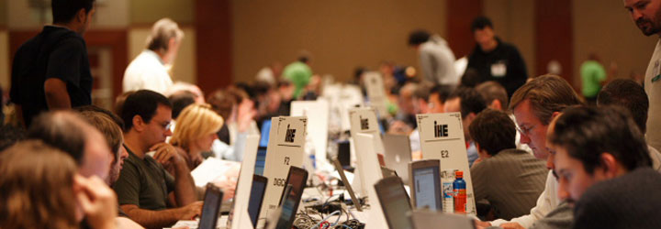
Connectathons
Neutral testing events with multiple vendors in one room, consisting of developers and testers (no marketing or sales / no customers), promoting rapid and robust interoperability testing
Benefit is that means that if your code fails on day 1 of Connectathon, you can hack it that night, and come back with something that only exists on the developers laptop, and try again on day 2
Whereas IHE Connectathons are organized testing with predefined test cases against published formal specifications, FHIR Connectathons have been traditionally more ad-hoc "hackathon“ organized around specific tracks
Source: https://www.ihe.net/connectathon.aspx

Slide 19
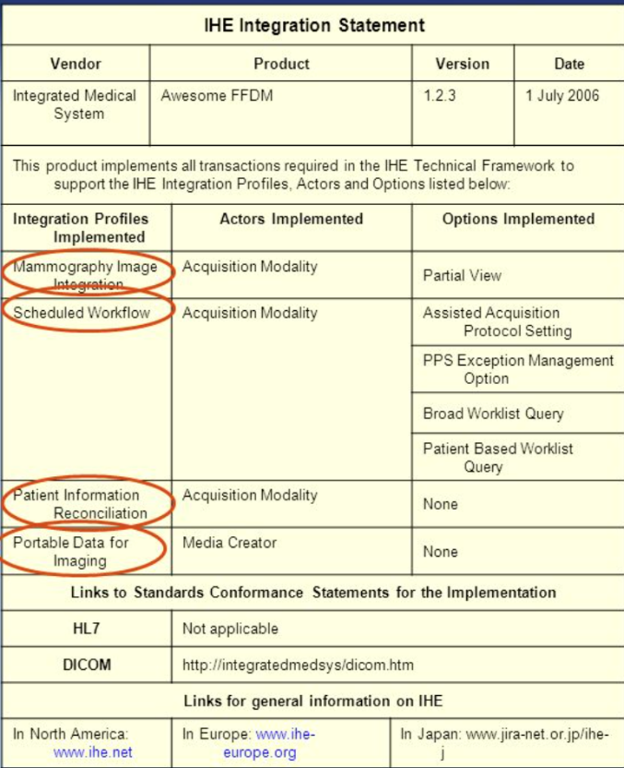
Publishing Integration Statements
End users use IHE integration statements as a way to know that a system is compliant, e.g., when evaluating an RFP response
Vendors publish integration statements that are usually available from their websites
IHE also voluntarily maintains a product registry
Source: https://www.ihe.net/FAQ/

Slide 20
IHE Domains
Cardiology
Dental
Eye Care
IT Infrastructure (ITI)
Pathology and Laboratory Medicine
Patient Care Coordination
Patient Care Devices
Pharmacy
Quality, Research and Public Health
Radiation Oncology
Radiology
Mammography
Nuclear Medicine
* Marked in red are domains using FHIR
Source: https://www.ihe.net/IHE_Domains/

Slide 21
Mobile
Most profiles from IHE that leverage FHIR have the word “Mobile” in their title.
Indicates FHIR was used
Does NOT restrict the use to non-Mobile use

Slide 22
Who is IHE? Organization Sponsors …
American Academy of Ophthalmologists (AAO)
American College of Cardiology (ACC)
American College of Clinical Engineering (ACCE)
American College of Physicians (ACP)
American Heart Association (AHA)
American Society for Therapeutic Radiology and Oncology (ASTRO)
Healthcare Information and Management Systems Society (HIMSS)
Radiological Society of North America (RSNA)
Society for Imaging Informatics in Medicine
European Association of Radiology (EAR)
European Congress of Radiologists (ECR)
Coordination Committee of the Radiological and Electromedical Industries (COCIR)
Deutsche Röntgengesellschaft (DRG)
EuroPACS Association
Groupement pour la Modernisation du Système d'Information Hospitalier (GMSIH)
Société Francaise de Radiologie (SFR)
Società Italiana di Radiologia Medica (SIRM)
British Institute of Radiology (BIR)
College of Radiographers
Institute of Physics and Engineering in Medicine
NHS Information Authority
Royal College of Radiologists (RCR)
Ministry of Economy, Trade, and Industry (METI)
Ministry of Health, Labor, and Welfare
MEDIS-DC
Japan Industries Association of Radiological Systems (JIRA)
Japan Association of Healthcare Information Systems Industry (JAHIS)
Japan Radiological Society (JRS)
Japan Society of Radiological Technology (JSRT)
Japan Association of Medical Informatics (JAMI)
… and more
In addition to these sponsoring organizations, IHE also has more than 135 member organizations
Source: https://www.ihe.net/Member_Organizations/

Slide 23

ITI PROFILES
IHE Profiles on FHIR®

Slide 24
ITI Profiles on FHIR
Mobile Access to Health Documents (MHD)
Audit Trail and Node Authentication (ATNA) - Query
Mobile Alert Communication Management (mACM)
mobile Care Services Discovery (mCSD)
Mobile Cross-Enterprise Document Data Element Extraction (mXDE)
Non-patient File Sharing (NPFS)
Patient Identifier Cross-reference for Mobile (PIXm)
Patient Demographic Query for Mobile (PDQm)
Internet User Authentication (IUA) – Special Mention

Slide 25
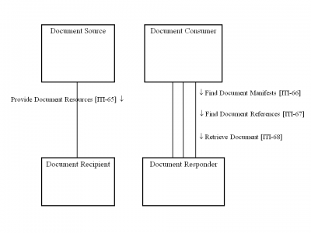
Mobile Access to Health Documents (MHD)
Defines FHIR interface to an XDS environment, and defines:
submit a set of documents and metadata from the mobile device to a document receiver,
find the document submission set metadata based on query parameters;
find document entries containing metadata based on query parameters, and
retrieve a copy of a specific document
DocumentReference, DocumentManifest, List, Patient, Practitioner, OperationOutcome, Bundle
Source: https://wiki.ihe.net/index.php/Mobile_access_to_Health_Documents_(MHD)

Slide 26
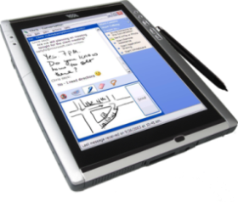
XDS-on-FHIR
Patient Identity Source
Document Registry
Document Consumer
MHD Document Responder
MHD Document Recipient
Document Source
Document Repository
MHD Document Source
MHD Document Consumer
Source: https://wiki.ihe.net/index.php/Cross-Enterprise_Document_Sharing

Slide 27
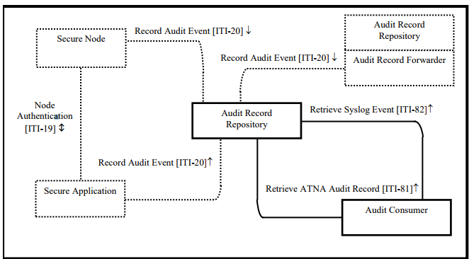
Audit Trail and Node Authentication (ATNA)
Establishes security measures which provide patient information confidentiality, data integrity and user accountability
FHIR was added for RESTful query of audit records
AuditEvent, Bundle
Source: https://wiki.ihe.net/index.php/Audit_Trail_and_Node_Authentication

Slide 28
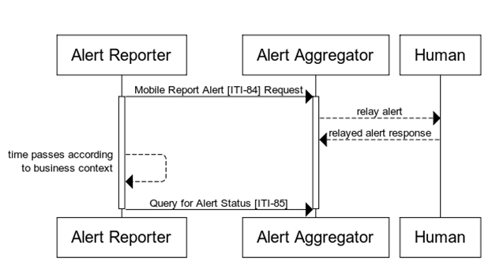
Mobile Alert Communication Management (mACM)
Provides ability to send short, unstructured text alerts to human recipients
Records the outcomes of any human interactions upon receipt of the alert
Allows for feedback mechanism to determine the status of an alert through the use of alert statuses
Communication, CommunicationRequest, OperationOutcome, Bundle
Source: https://wiki.ihe.net/index.php/Mobile_Alert_Communication_Management(mACM)

Slide 29
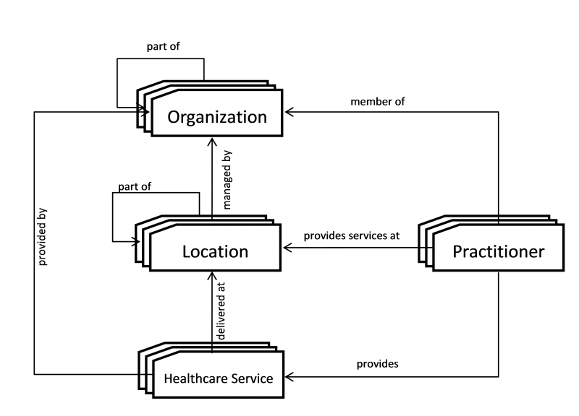
Mobile Care Services Discovery (mCSD)
Supports discovery of a number of care service resources
Organizations such as Healthcare Information Exchanges (HIEs), Integrated Delivery Networks (IDNs), or family practices
Location are physical care delivery sites such as hospitals, clinics, health outposts, physician offices, labs, pharmacies
Practitioners are healthcare workers like physicians, nurses, or pharmacists
Healthcare Services can include surgical services, antenatal care services or primary care services
Organization, Location, Practitioner, PractitionerRole,
HealthcareService, OperationOutcome, Bundle
Source: https://wiki.ihe.net/index.php/Mobile_Care_Services_Discovery_(mCSD)

Slide 30
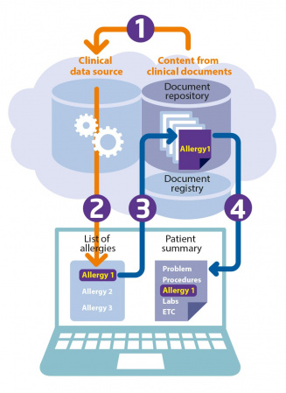
Mobile Cross-Enterprise Document Data Element Extraction (mXDE)
Provides means to access data elements extracted from shared structured documents
Enables the deployment of health data exchange infrastructures where fine-grained access to health data coexists and complements the sharing of coarse-grained documents and the fine-grained data elements they contain
Observation, AllergyIntolerance, Condition, DiagnosticReport, Medication, MedicationStatement, MedicationRequest, Immunization, Procedure, Encounter, Provenance, OperationOutcome, Bundle
Source: https://wiki.ihe.net/index.php/Mobile_Cross-Enterprise_Document_Data_Element_Extraction

Slide 31
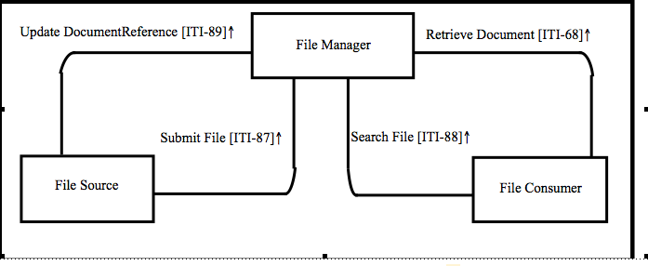
Non-patient File Sharing (NPFSm)
Defines how to enable the sharing of non-patient files
Files can be created, consumed and updated by many different systems involved in a wide variety of data sharing workflows
DocumentReference, OperationOutcome, Bundle
Source: https://wiki.ihe.net/index.php/Non-patient_File_Sharing_(NPFSm)

Slide 32
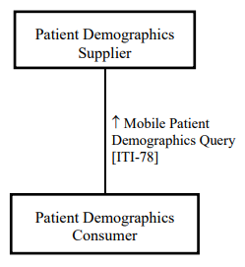
Patient Demographics Query for Mobile (PDQm)
Defines interface to patient demographics supplier, to be used in many use cases:
A health portal securely exposing demographics data to browser based plugins
Medical devices which need to access patient demographic information
Mobile devices used by physicians (example bedside eCharts) which need to establish patient context by scanning a bracelet
Patient, OperationOutcome, Bundle
Source: https://wiki.ihe.net/index.php/Patient_Demographics_Query_for_Mobile_(PDQm)

Slide 33
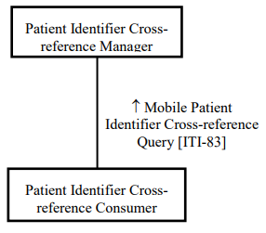
Patient Identifier Cross-Reference for Mobile (PIXm)
Provides ability to query for list of patient identifiers based on the patient identifier in a different domain and retrieve a patient’s cross-domain identifiers information
Deals only with patient IDs - covers cases where you don't want to disclose/exchange more of the patient resource
Patient, Operation, Parameter, OperationOutcome, Bundle
Source: https://wiki.ihe.net/index.php/Patient_Identifier_Cross-Reference_for_Mobile_(PIXm)

Slide 34
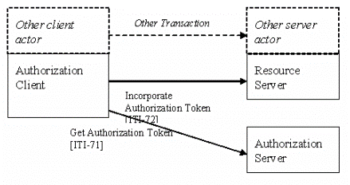
Internet User Authentication (IUA) – Special Mention
Actors should not communicate any patient information unless proper authentication, authorization, and communications security have been performed
Profile of the OAuth protocol
IUA enables external Authorization providers, which can leverage pluggable authentication providers
Network communication security and user authentication are layered in at the HTTP transport layer and do not modify the interoperability characteristics
Source: https://wiki.ihe.net/index.php/Internet_User_Authorization

Slide 35
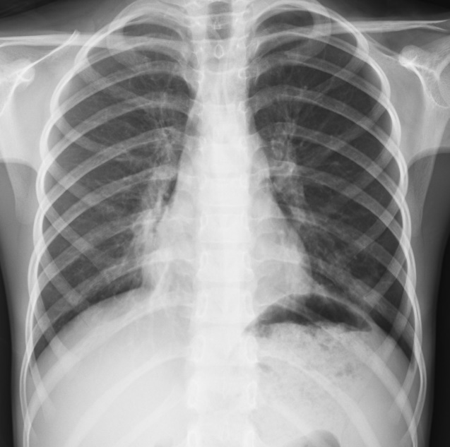
RADIOLOGY PROFILES
IHE Profiles on FHIR®

Slide 36
Radiology Profiles on FHIR
Standardized Operational Log of Events (SOLE)
Special mention as these use compatible DICOM web
Web Image Capture (WIC)
Web Image Access (WIA) formerly called MHD-I
Invoke Image Display (IID) - Special mention

Slide 37
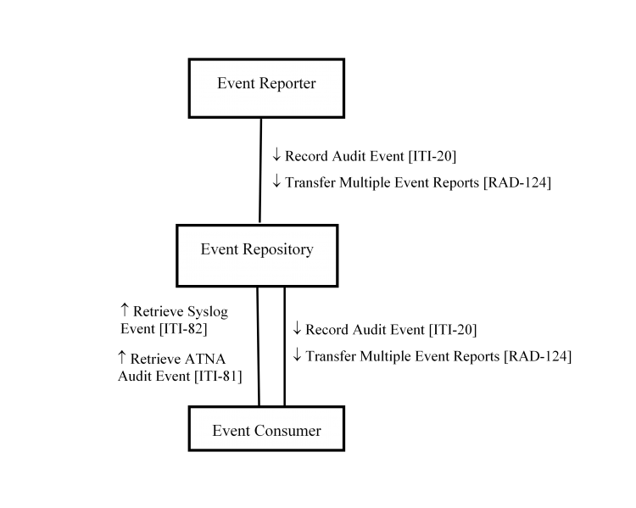
Standardized Operational Log of Events (SOLE)
Supports business intelligence tools
Information often resides in several different systems, and there are not standard ways to obtain the information
SOLE defines a way to exchange information about events that can then be collected and displayed using standard methods
AuditEvent, Bundle
Source: https://wiki.ihe.net/index.php/Standardized_Operational_Log_of_Events_(SOLE)

Slide 38

Patient care coordination Profiles
IHE Profiles on FHIR®

Slide 39
Patient Care Coordination Profiles on FHIR
Clinical Mapping (CMAP)
Dynamic Care Planning (DCP)
Dynamic Care Team Management (DCTM)
Point of Care Medical Device Tracking (PMDT)
Query for Existing Data for Mobile (mQED)
Reconciliation of Clinical Content and Care Providers (RECON)
Remote Patient Monitoring (RPM)
Routine Interfacility Patient Transport (RIPT)
Emergency Transport to Facility (ETF)

Slide 40
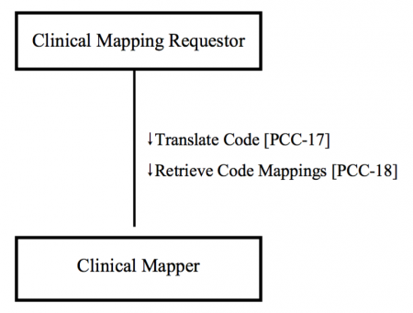
Clinical Mapping (CMAP)
Supports the need of systems to translate codes from one terminology to another to support exchange of information between different systems
Often needed at workflow boundaries where concepts used in one workflow have different names than those in another workflow
ConceptMap, Parameters
Source: https://wiki.ihe.net/index.php/Clinical_Mapping

Slide 41
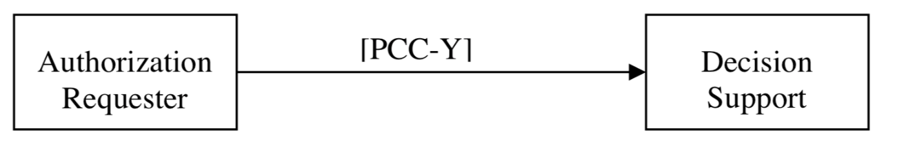
Guideline Appropriate Ordering (GAO)
Support communication of decision support guidance on whether or not an order is appropriate from EHR, hospital or departmental information systems
Enable receivers to validate that decision support was used to determine the appropriateness of those orders according to guidelines
Authorization, Order, Practitioner, Questionnaire, Parameters, Patient, Provider, DiagnosticOrder, QuestionnaireResponse
Source: https://www.ihe.net/uploadedFiles/Documents/PCC/IHE_PCC_Suppl_GAO.pdf

Slide 42
Dynamic Care Planning (DCP) - Update
Care Plans can be dynamically created from tools used to support evidence-base practice
Care Plans can be dynamically updated as the patient interacts with the healthcare system
Provides structures and transactions for care planning
Promotes sharing Care Plans that meet the needs of many, such as providers, patients and payers
Care Plan Contributor
Update 2018
↓ Search for Plan Def [PCC-Y3]
↓ Retrieve Plan Def [PCC-Y2]
↓Update Plan Def [PCC-Y1]
↓ Subscribe to Plan Def Updates [PCC-Y4]
↑ Provide Plan Def [PCC-Y5]
↑ Provide Activity Def [PCC-Y6]
↓Apply Care Plan Operation [PCC – Y7]
↓Update Care Plan [PCC-37]
↓ Search for Care Plan [PCC-41]
↓ Retrieve Care Plan [PCC-38]
↓ Subscribe to Care Plan Updates [PCC-39]
↑ Provide Care Plan [PCC-40]
Care Plan Guidance Service
Care Plan Service
CarePlan, Subscription, PlanDefintion, ActivityDefinition
Source TBA

Slide 43
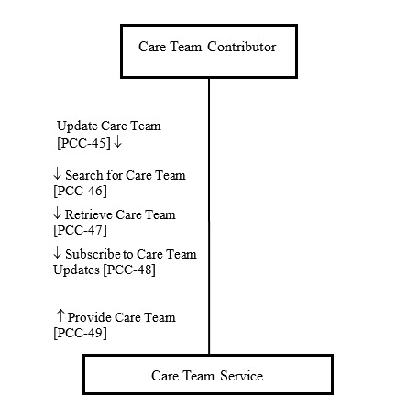
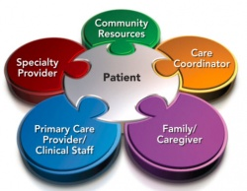
Dynamic Care Team Management (DCTM)
Provide a mechanism to facilitate system interactions to support care team membership such as:
Discovering Care Teams
Creating/updating Care Teams
Listing Care Teams
CareTeam, Subscription
Source: https://wiki.ihe.net/index.php/Dynamic_Care_Team_Management

Slide 44
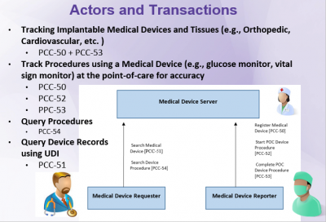
Point-of-Care Medical Device Tracking (PMDT)
Closes the loop on data acquisition at the point-of-care in support of reporting data about implantable medical devices (e.g., pacemaker, titanium plates) and medical devices (e.g., vital sign monitors, pulse oximeters, blood glucose monitors) during a procedure
Enables information it to be retrieved and reused at a later time
Device, Procedure
Source: https://wiki.ihe.net/index.php/Point-of-Care_Medical_Device_Tracking

Slide 45
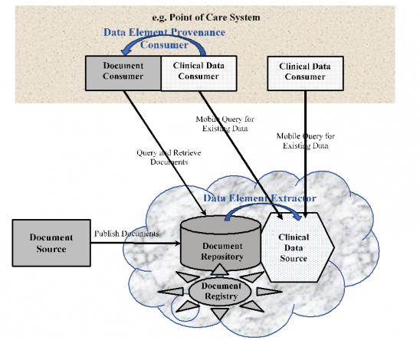
Query for Existing Data for Mobile (mQED)
Supports queries for clinical data elements (e.g., observations, allergies, etc.) by making the information widely available to other systems within and across enterprises
Aimed at class of systems that are resource- and platform-constrained (e.g., tablets, smartphones, and embedded devices including home-health devices)
Observation, AllergyIntolerance, Condition, DiagnosticReport, Medication, MedicationStatement, MedicationRequest, Immunization, Procedure, Encounter, Provenance, OperationOutcome, Bundle
Source: https://wiki.ihe.net/index.php/Query_for_Existing_Data_for_Mobile

Slide 46
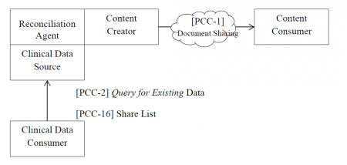
Reconciliation of Clinical Content and Care Providers (RECON)
Provides the structures and transactions needed to communicate the list of reconciled items, when they were reconciled and who did the reconciliation
Ability to maintain the support of care provision is essential as data is exchanged
Used to facilitate identification of duplicated, overlapping, conflicting or superseded items that may be introduced as a result of sematic interoperability.
Provenance, List
Source: https://wiki.ihe.net/index.php/Reconciliation_of_Clinical_Content_and_Care_Providers

Slide 47
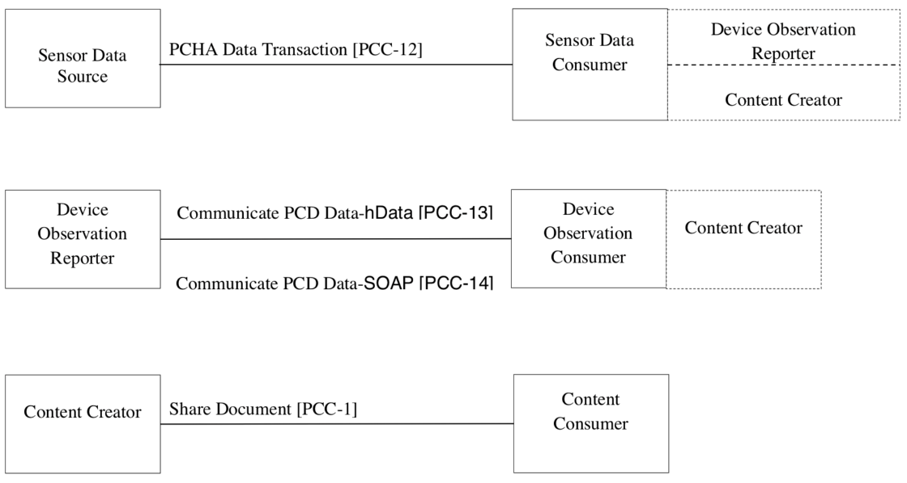
Remote Patient Monitoring (RPM)
Provides means of reporting measurements taken by Personal Healthcare devices in a remote location
E.g. outside of the healthcare provider facilities and is typically the patient’s home, and reporting those measurements to the health care provider
Uses FHIR profiles
Source: https://en.wikipedia.org/wiki/Remote_patient_monitoring

Slide 48
Routine Interfacility Patient Transport (RIPT)
Provides means of updating a Transport team with critical and necessary medical information on a patient to be transported
FHIR RESTful query
Document Sharing with
CDA template for RIPT
Transport Data Consumer
Transport Data Responder
Query for Transport Data [PCC-62]
Content Creator
Document Sharing
Content Consumer
Patient, RelatedPerson, Coverage, Practitioner, Claim, AllergyIntolerance, Procedure, Immunization, MedicationStatement, ClinicalImpresion, DiagnosticOrder, DiagnosticReport, ImagingStudy, Observation, Condition, Location
Source: http://wiki.ihe.net/index.php/Routine_Interfacility_Patient_Transport

Slide 49
Emergency Transport to Facility (ETF)
Provides means for Emergency Transport to inform destination Hospital with critical and necessary medical information on a patient to be transported
FHIR RESTful query
Document Sharing with
CDA template for RIPT
New 2018
Transport Data Consumer
Transport Data Responder
Query for Transport Data [PCC-62]
Content Creator
Document Sharing
Content Consumer
Patient, RelatedPerson, Coverage, Practitioner, Claim, AllergyIntolerance, Procedure, Immunization, MedicationStatement, ClinicalImpresion, DiagnosticOrder, DiagnosticReport, ImagingStudy, Observation, Condition, Location
Source TBA

Slide 50
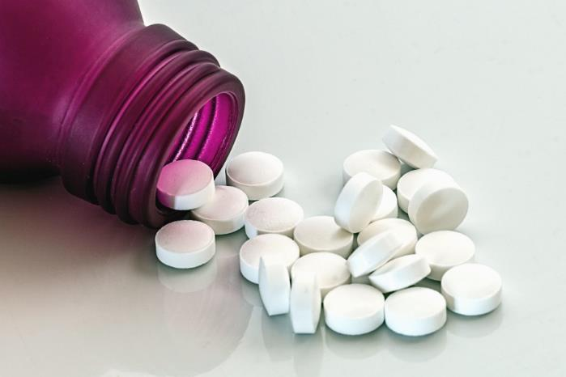
Pharmacy PROFILES
IHE Profiles on FHIR®

Slide 51
Pharmacy Profiles on FHIR
Mobile Medication Administration (MMA)
Uniform Barcode Processing (UBP)

Slide 52
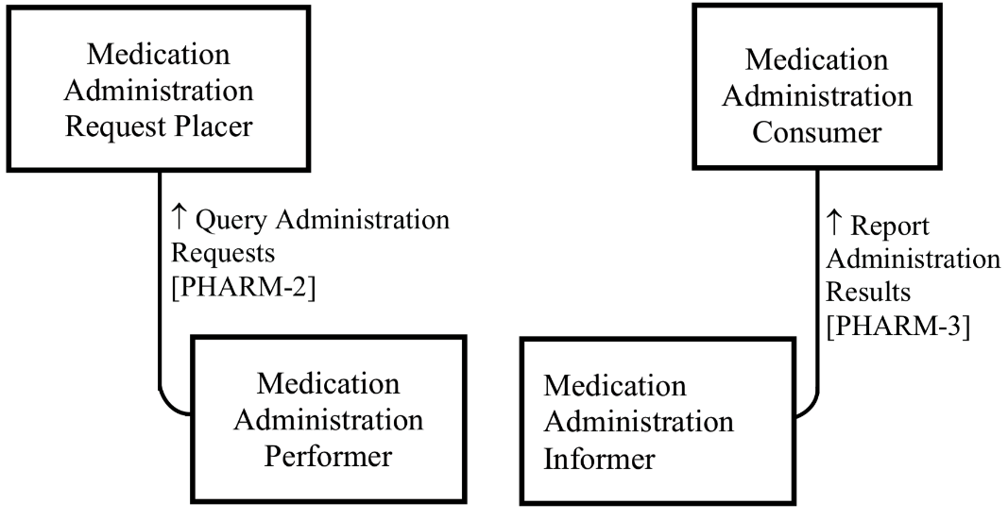
Mobile Medication Administration (MMA)
Populates the mobile device with a list of scheduled medications from the EHR
Sends the report of administrations to the EHR or any other system
Example Use Case
Patient app that receives scheduled administrations from the pharmacy system or hospital system, and reminds the patient
Patient, Medication, MedicationRequest, MedicationAdministration
Source: https://wiki.ihe.net/index.php/Mobile_Medication_Administration

Slide 53
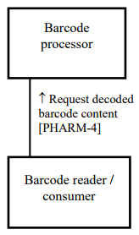
Uniform Barcode Processing (UBP)
Use of barcodes and other automatic identification and data capture (AIDC) in healthcare is increasing
Barcodes contain data that is encoded in a certain way. In order to be able to use that data, software systems need to “understand” the barcode
Defines a FHIR Operation
$decode-barcode(string, …)
Medication, Device, Patient
Source: http://www.ihe.net/uploadedFiles/Documents/Pharmacy/IHE_Pharm_Suppl_UBP_Rev1.0_PC_2017-10-19.pdf

Slide 54

Quality, Research and Public Health PROFILES
IHE Profiles on FHIR®

Slide 55
QRPH Profiles on FHIR
Mobile Retrieve Form for Data Capture (mRFD)
Vital Records Death Reporting (VRDR)
Birth and Fetal Death Reporting – Enhanced (BFDE)
Quality Outcome Reporting for EMS (QORE)

Slide 56
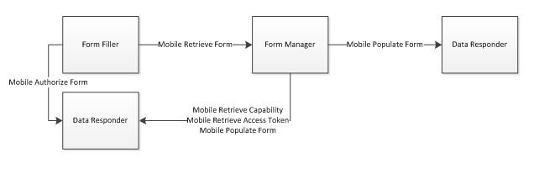
Mobile Retrieve Form for Data Capture (mRFD)
Provides a method for gathering data within a user’s current application to meet the requirements of an external system
Supports retrieval of forms from a form source, display and completion of a form, and return of instance data from the display application to the source application
Bundle, ANY resource
* Also uses SMART on FHIR
Source: https://wiki.ihe.net/index.php/Mobile_Retrieve_Form_for_Data_Capture

Slide 57
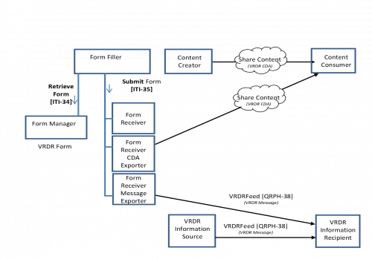
Vital Records Death Reporting (VRDR)
Supports pre-population of data from electronic health record systems to electronic vital records systems for death reporting
Establishes interoperable electronic exchange of VR data between EHR and VR Systems
Higher quality data for demographic and epidemiologic surveillance and research
Patient, Composition, Condition, Observation, Practitioner, Patient, Procedure, RelatedPerson, Location
Source: https://wiki.ihe.net/index.php/Vital_Records_Death_Reporting

Slide 58
Birth and Fetal Death Reporting – Enhanced (BFDE)
Supports pre-population of data from electronic health record systems to electronic vital records systems for birth and fetal death reporting
Establishes interoperable electronic exchange of VR data between EHR and VR Systems
Higher quality data for demographic and epidemiologic surveillance and research
…
New 2018
TBA
Source: TBA

Slide 59
Quality Outcome Reporting for EMS (QORE)
Supports transmission of clinical data for use in calculating Emergency Medical Services Quality measures
Establishes interoperable exchange between EMS and EHR systems
New 2018
TBA
Source: TBA

Slide 60
Conclusions
IHE Profiles on FHIR®

Slide 61
IHE and DICOMweb on FHIR
25 Profiles and growing
IT Infrastructure (ITI) - 8
Patient Care Coordination - 10
Pharmacy - 2
Quality, Research and Public Health - 4
Radiology - 1

Slide 62
References
https://wiki.ihe.net/index.php/Category:FHIR
http://www.ihe.net/uploadedFiles/Documents/ITI/IHE_ITI_Suppl_Appx-Z.pdf
ftp://ftp.ihe.net/TF_Implementation_Material/fhir/
Blog – John Moehrke’s Healthcare Exchange Standards
https://healthcaresecprivacy.blogspot.com

Slide 63
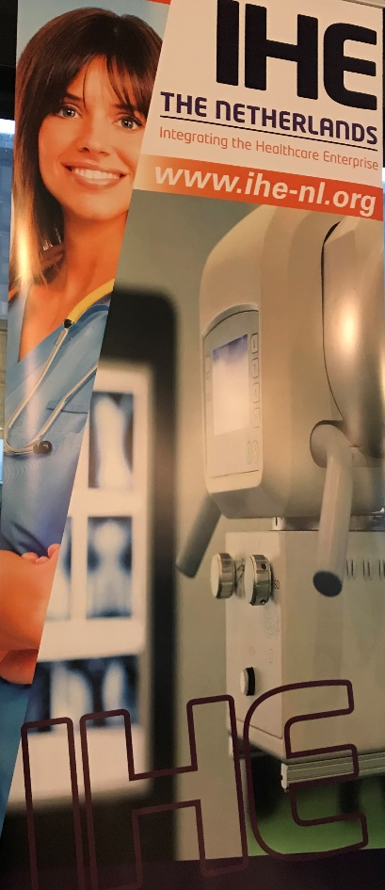
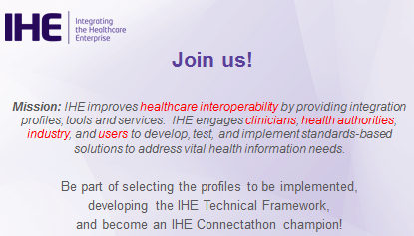

Get Involved
Join IHE by visiting: https://www.ihe.net/

Slide 64
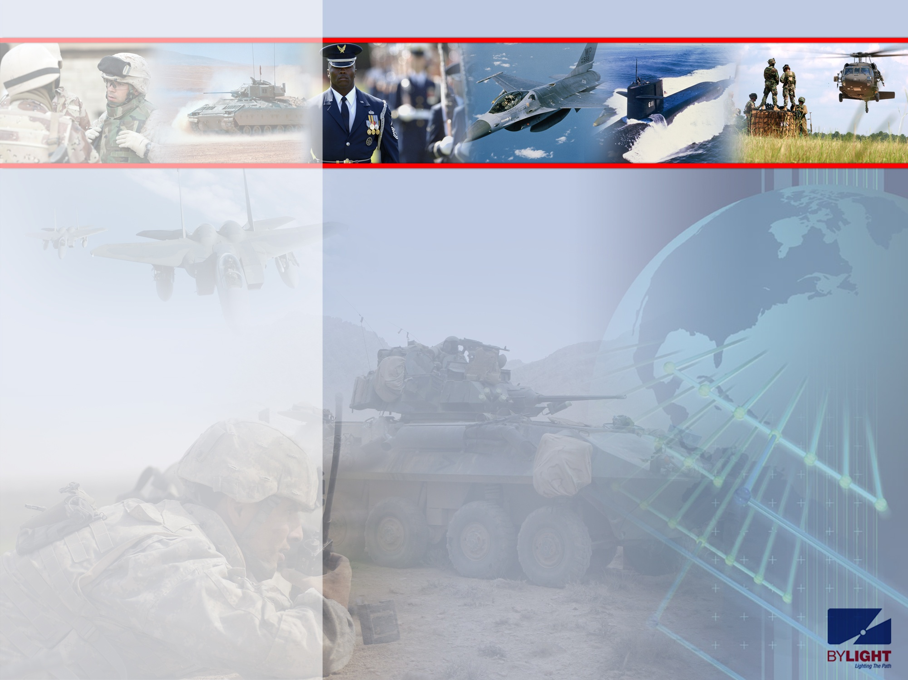
Questions?
John Moehrke
Gmail JohnMoehrke
Twitter JohnMoehrke
Skype johnmoehrke
Blog healthSecPrivacy.blogspot.com

Slide 65
Presentation Acknowledgements
Brad Genereaux
Harry Solomon
Kevin O’Donnell
Dr. S. Mendelson
Don Dennison
Chris Lindop
David Clunie
Kinson Ho
John Moehrke
Elliot Silver
IHE Website and all members contributing to IHE domain knowledge and profiles

Slide 66
Google Image Search Acknowledgements
The following images were found using Google Image Search, using “labelled for reuse” filter
Twitter icon https://cdn.pixabay.com/photo/2014/04/03/11/53/twitter-312464_960_720.png
LinkedIn icon https://upload.wikimedia.org/wikipedia/commons/thumb/e/e9/Linkedin_icon.svg/768px-Linkedin_icon.svg.png
X-Ray button https://upload.wikimedia.org/wikipedia/commons/thumb/8/8f/X-rays_chest_neg_icon.svg/1024px-X-rays_chest_neg_icon.svg.png
Computer construction https://cdn.pixabay.com/photo/2013/07/13/13/46/computer-161501_960_720.png
Radiology sample image https://upload.wikimedia.org/wikipedia/commons/1/1b/Radiology_ND_0125_ACJ.jpg
Coordination image https://upload.wikimedia.org/wikipedia/commons/5/5a/Beta-sodium-metavanadate-xtal-1984-V-coordination-CM-3D-balls.png
Drugs https://pixnio.com/free-images/2017/06/08/2017-06-08-13-26-19-900x600.jpg
Community health https://upload.wikimedia.org/wikipedia/commons/thumb/5/52/Noun_project_620.svg/1000px-Noun_project_620.svg.png

Slide 67
HL7, DICOM, and IHE Website Acknowledgements
The following pages and attached images were referenced:
IHE Logo https://www.ihe.net/images/logo.png
Connectathon https://www.ihe.net/uploadedImages/Content/Participate/2.1-ihe_na_connectathon08.jpg?n=6722
Sample integration statement http://slideplayer.com/694835/2/images/15/Example+IHE+Integration+Statement+IHE+Integration+Statement.jpg
FHIR Logo https://www.hl7.org/fhir/assets/images/fhir-logo-www.png
DICOM Logo http://dicom.nema.org/dicomhome/IMAGES/Logo2011-2.jpg
IHE at FHIR DevDays https://www.linkedin.com/feed/update/urn:li:activity:6338007643260485632/ (shared by Onno Gabel)

Slide 68
By Light Professional IT Services (End of Presentation)

